Slide 1
Co-localization of DSSQ1 with TMRM
Hoechst
DSSQ1
TMRM
Combined

Slide 2
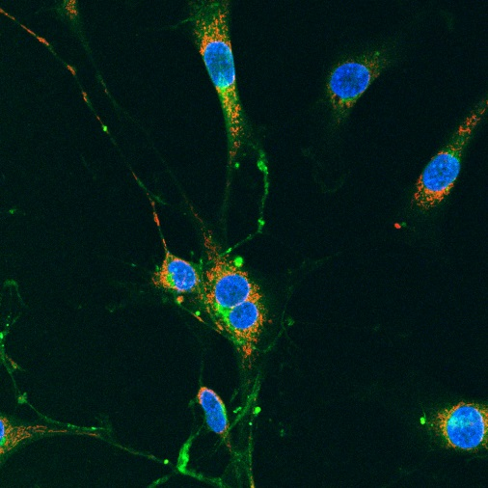
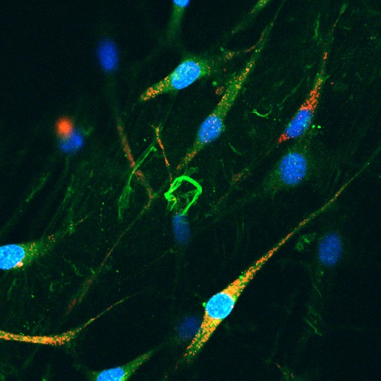
Co-localization of DSSQ1 with LysoTrackerRed
Control
Lyso-Tracker Red
Hoechst
DSSQ1
Hoechst
DSSQ1
40uM
40uM
40uM
40uM
TMRM
Combined
LysoRed
Combined
40uM
40uM
40uM
40uM

Slide 3
Effect of 30 min Co-incubation of NIH/3T3 cells with
H₂0₂ (100 µM) and DSSQ1 (20 µM)
Control
H₂0₂ 100 µM
Hoechst
DSSQ1
Hoechst
DSSQ1
TMRM
Combined
TMRM
Combined

Slide 4
Effect of 30 min Co-incubation of NIH/3T3 cells with
N-Acetyl Cysteine (10 mM) and DSSQ1 (20 µM)
Control
NAC 10 mM
Hoechst
DSSQ1
Hoechst
DSSQ1
TMRM
Combined
TMRM
Combined

Slide 5
Effect of 30 min Co-incubation of NIH/3T3 cells with
H₂O₂ (100 µM), N-Acetyl Cysteine (10 mM) and DSSQ1 (20 µM)
Control
H₂0₂ 100uM + NAC 10uM
Hoechst
DSSQ1
Hoechst
DSSQ1
TMRM
Combined
TMRM
Combined

Slide 6
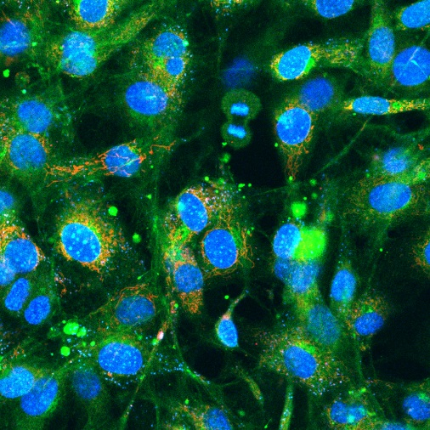
Effects of 30 min Pre-incubation of NIH/3T3 cells with H₂0₂ on DSSQ1 uptake
Control
H₂0₂ 100 µM
Hoechst
DSSQ1
Hoechst
DSSQ1
40uM
40uM
40uM
40uM
TMRM
Combined
TMRM
Combined
40uM
40uM
40uM
40uM

Slide 7
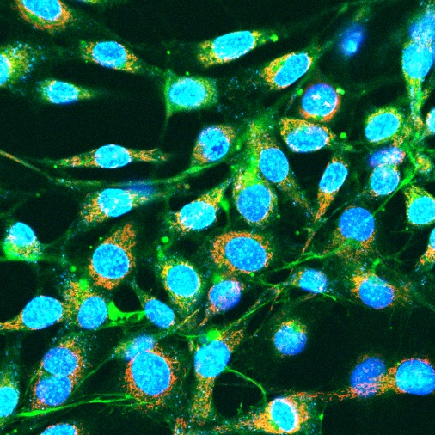
Effects of Pre-incubation with N-Acetyl Cysteine on DSSQ1
Control
NAC 10 mM
Hoechst
DSSQ1
Hoechst
DSSQ1
40uM
40uM
40uM
40uM
TMRM
Combined
TMRM
Combined
40uM
40uM
40uM
40uM

Slide 8
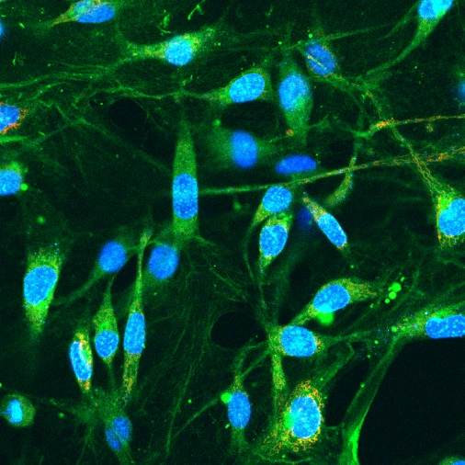
Effect of 30 min Preincubation of NIH/3T3 cells with
NAC (1 mM) and DSSQ1 (20 µM)
Control
NAC 1 mM
Hoechst
DSSQ1
Hoechst
DSSQ1
40uM
40uM
40uM
40uM
TMRM
Combined
TMRM
Combined
40uM
40uM
40uM
40uM

Slide 9
